Slide 1
Book Recommendation System
Mariam Yahya Mourad

Slide 2
Agenda
Project Benefits
Technical Explanation
Dataset
EDA & Data Pre-processing
Models

Slide 3
Project Benefits
Save time & decreases risk to readers
Increases the chance of the book to be found
More sales

Slide 4
Datasets
Dataset | Observations | Columns
Books | 271,360 | ISBN, title, author, year of publication, publisher, imgUrlS, imgUrlM, imgUrlL
Users | 278,858 | user id, location, age
Ratings | 1,149,780 | user id, ISBN, rating

Slide 5
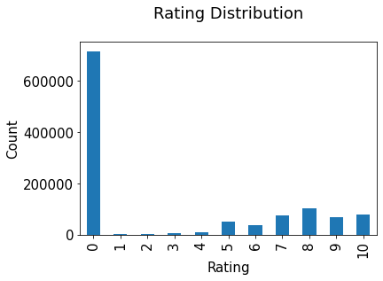
EDA & Data Pre-processing

Slide 6
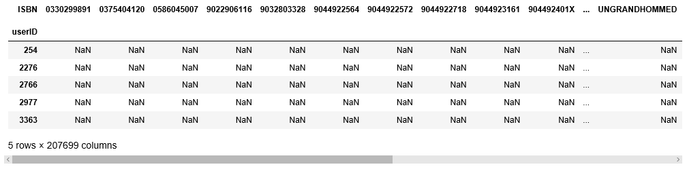

Slide 7
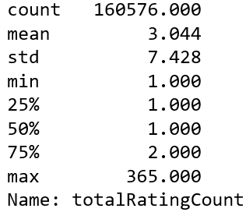

Slide 8
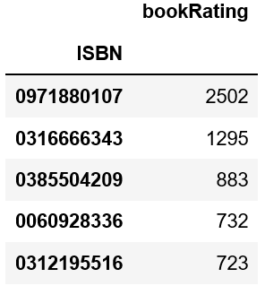
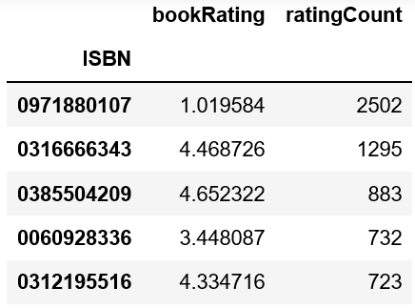
Ratings Count VS Ratings Average

Slide 9
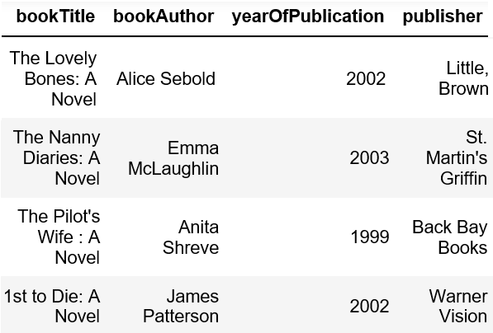
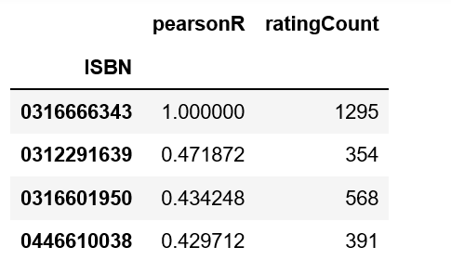
Pearson Correlation Based Model
Pearson correlation coefficient is measure of linear correlation between two sets of data.

Slide 10
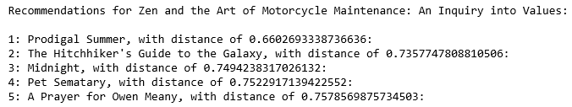
K Nearest Neighbors KNN
Cosine similarity to calculate the distance.

Slide 11
Thank you!

